Slide 1
Innovative test solution
Provider
- Probe pin Datasheet -

Slide 2
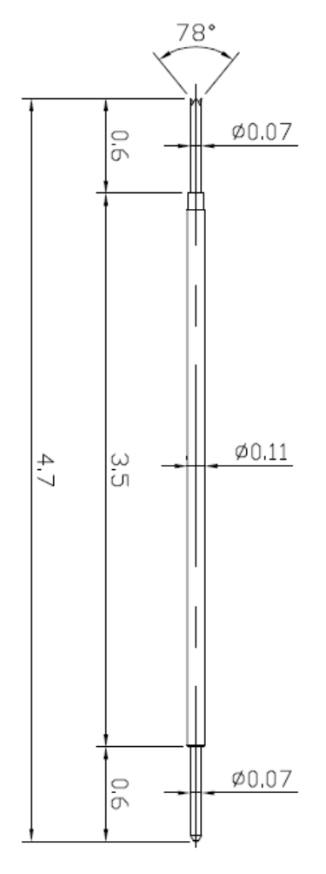
※ Special – POGO pin for 0.2 pitch
IVB-SCR-470-011-A144-00
Pitch | 0.2 mm
Total Length | 4.7 mm
Use Length | 4.3 mm
Use Stroke | 0.4 mm
Max Stroke | 0.5 mm
Spring Force at Use Stroke | 6 gf at 0.4 mm stroke
Operating Temperature | -45 to +125℃
DC Resistance | Avg. 350 mΩ at 0.3 mm stroke
Current Rating | 0.2 A
Self Inductance | 1.72 nH
Capacitance | 0.5 pF
Bandwidth @ -1dB | 9.8 GHz
Top Plunger | Pd Alloy
Bottom Plunger | Pd Alloy
Barrel | Alloy
Spring | Music wire / Au
Insertion Life | 100,000 cycles

